Slide 1
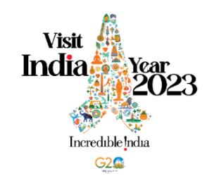
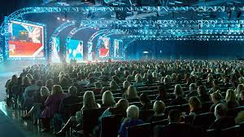
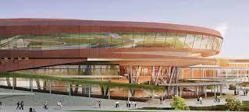
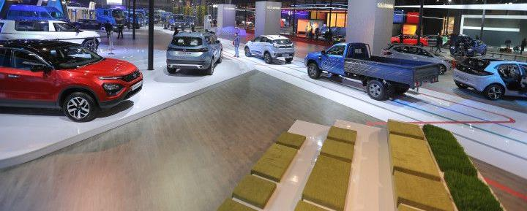
Accelerating Tourism India
MICE Tourism
Notes:
https://www.imagesbazaar.com/previewImage/BY130375/ladakh/0/0/0/0/0/10/2

Slide 2
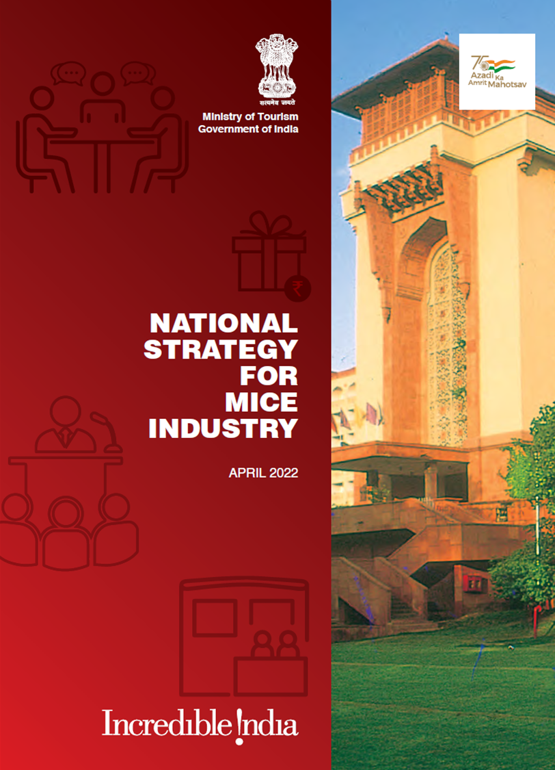
Content
Introduction
Key Strategic Pillars
Governance and Institutional Framework
State and City Ranking of MICE Ecosystem
Making India MICE Industry Competitive
Ease of Doing Business for MICE Events
Promoting MICE India Brand
Skill Development and Capacity Building

Slide 3
Introduction
MICE is an acronym for Meetings, Incentives, Conferences and Exhibitions
India with 158 meetings was at 28th rank as per 2019 ICCA rankings
Medical (17%), Technology (15%) and Science (13%) are the three most popular
Indian MICE has less than 1% share in the estimated global MICE business
As per ICCA, there are only 7 Indian cities in the top 475 cities

Slide 4
Key Strategic Pillars
Institutional support for MICE
Developing Eco-system for MICE
Enhance competitiveness of Indian MICE industry
Enhance ease of doing business for MICE events
Marketing India as a MICE destination
Skill development for MICE industry

Slide 5
Governance and Institutional Framework
National Advisory Council for MICE
National Advisory Council will meet at least once in a year or more and will lay down overall vision for growth of MICE industry in the country and provide strategic direction.
India MICE Board
India MICE Board will coordinate implementation of various initiatives, strategies to facilitate growth of MICE industry in India.
State Level Support
State MICE Promotion Committee will be set up under Chief Secretary comprising of representatives of various relevant Government Departments and Industry Stakeholders.
State MICE Promotion Bureau
An independent organization under Tourism Department or as a division of Tourism Development Board/ Corporation or other agency

Slide 6
State and City Assessment and Ranking of MICE Ecosystem
Enabling Role of Central and State Governments
Central Government will be responsible for promoting India in overseas markets, developing aviation infrastructure, liberal VISA regime etc.
State governments must ensure that any City to be positioned as MICE destination shall have at least one good international level convention center
Ranking of the States and Cities on MICE Ecosystem
The Ministry of Tourism will conduct ranking of the States and Cities
The broad areas and action points for ranking exercise will be taken from global rankings of countries
The ranking exercise will be carried out with professional support and through independent experts from various Institutions both Government and Private

Slide 7
Making India MICE Industry Competitive
Infrastructure status for financing of MICE infrastructure
Ministry of Tourism will pursue to expand the list of cities for grant of infrastructure to MICE infrastructure projects such as Hotels and Resorts, Exhibition and Convention Centres etc.
Industry Status to MICE infrastructure by States
MICE infrastructure should be granted the Status of Industry by the States
Public Private Partnership for developing MICE Infrastructure
The States can make suitable land available under Public Private Partnership to the Private Sector for setting up and operating the MICE facilities.
India MICE Advantage Program
Industry should also be supported by way of various financial incentives to give Indian destinations advantage in attracting MICE events

Slide 8
Ease of Doing Business for MICE events
Access to Major Monuments and other attractions
Special timings of before opening hour at major Monuments will be allowed for MICE events
Welcome at the Airports and Railway Stations
Facilitation Counter at major International Airport for major MICE events and designated Coach Parking areas at International airport for MICE delegates
Group Bookings in Indian Railways for MICE events should be allowed
Single Window Clearance for NOCs
MICE promotion Bureaus will act as single window to provide all NOCs to the organisers
Issuance of letter for VISA to the delegates
National MICE Bureau, State Bureaus and City Bureaus may be authorized to issue letters or VISA to the delegates

Slide 9
Promoting MICE India Brand
“Meet in India” Brand
In order to position India as a MICE destination and create awareness and positive perception, a sub brand “Meet in India” under Incredible India will be launched.
Familiarization Trips
Central and State Governments may organize familiarization trips for Associations, PCOs, Corporates and other key MICE stakeholders to showcase MICE destinations.
Annual iMICE India event
Incredible MICE India (iMICE India) will be an annual flagship event to be organized by Ministry of Tourism and ICPB in line with the world class events like IMEX Frankfurt, IBTM Barcelona, IT&CMA Thailand

Slide 10
Skill development and Capacity Building for MICE Industry
MICE Facilitators Program
MICE Facilitator Program to cover the range of activities and relevant skill sets will be launched by the Ministry of Tourism in partnership with Ministry of Skill Development
Capacity Building of MICE enterprises
The Ministry of Tourism will work with the States and Industry Stakeholders for professional development and growth of micro, small and medium enterprises
Capacity Building of MICE Promotion Bureaus
Provide handholding and capacity building support to various State/ City Bureaus for developing their organizational goals and competencies in their manpower for fulfilling their roles and responsibilities.

Slide 11
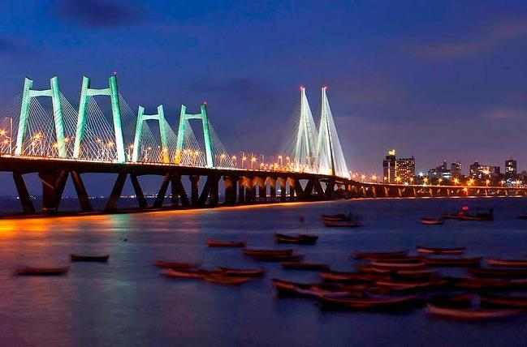
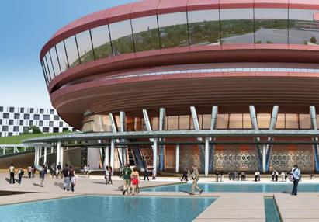
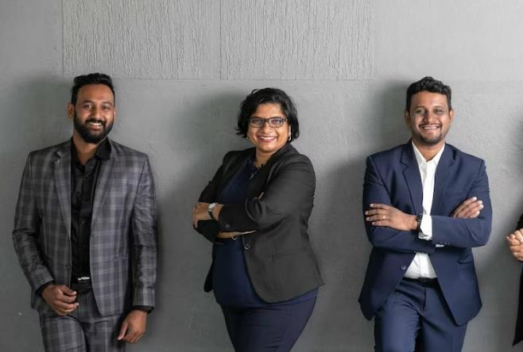
Inviting the MICE market to discover a country that is
# the home of ambition

Slide 12
DRIVING SPOTLIGHT ON KEY CITIES INCLUDING G20 HOSTS
New Delhi
Mumbai
Hyderabad
Pune
Jaipur
Chandigarh
Chennai
Lucknow
Kolkata
Puducherry
Surat
Bengaluru
Indore
Nagpur
Udaipur
Coimbatore
Agra
Shimla
Varanasi
Rishikesh
Visakhapatnam
Patna
Bhopal
Amritsar
Jodhpur
Guwahati
Raipur
Gandhinagar
Gurugram
Mysore
Thiruvananthapuram
Bhubaneswar
Srinagar
Ranchi
Kochi
Siliguri
Darjeeling
Jammu
Hampi
Shillong
Gangtok
Mahabalipuram
Khajuraho
Diu, India
Port Blair
Dibrugarh
Agartala
Dimapur
Amaravati
Kutch
Imphal
Itanagar
Aizawl
Greater noida
Kevadiya
Kavaratti
Dispur
Daman
Panaji
Leh

Slide 13
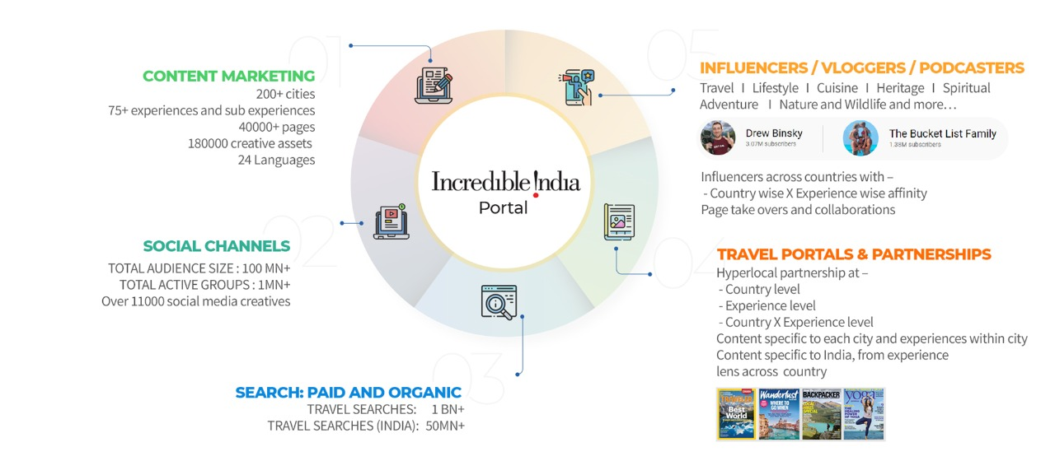
A MULTI-PRONGED MODEL FOR MICE CAMPAIGN
STRATEGIC ENGAGEMENT WITH
EVENT MANAGEMENT INDUSTRY
VIRTUAL EVENTS
CONTENT MARKETING
COMMUNITY INTERVENTIONS
PARTNERSHIPS WITH ASSOCIATIONS
CORPORATE AND SMB INFLUENCERS/COACHES/ETC
IDENTIFIED TOP NAMES FROM ACROSS OVERSEAS MARKETS AND REGIONS
ACROSS INDUSTRIES
# the home of ambition
MICE
BUSINESS AND EVENT MANAGEMENT PUBLICATIONS
PARTNERSHIPS AT COUNTRY / REGION LEVEL
EDITORIAL CONTENT, SOCIAL MEDIA INTEGRATION, ETC
SOCIAL MEDIA CAMPAIGNS
MONTHLY ASSETS
TENTPOLE CAMPAIGNS DURING LINKEDIN FOCUS
2.4 Mn Intent audience
IMMERSIVE EXPERIENCES AT MARQUEE EVENTS (OFFLINE/VIRTUAL)
SUCH AS IMEX AMERICA
PARTNERSHIPS WITH
STATE LEVEL MICE ASSOCIATIONS
UNLOCKING THE COMBINED REACH OF STATE LEVEL MICE ASSOCIATIONS
350K Global Searches
SEARCH MARKETING
GLOBAL & DOMESTIC SEARCHES RELATED TO MICE TOURISM
ADVOCACY CAMPAIGNS
PLANNED EVANGELISM CAMPAIGNS WITH IDENTIFIED BUSINESS LEADERS & BRANDS

Slide 14
THE ACTIVATION SCHEDULE
JULY
AUG
SEP
CAMPAIGN FLOW
Linkedin posts
Pre buzz
activities
Linkedin videos
Micro engagements
Campaign Launch
Hero
Campaign
Launch
Business coaches and influencers
Social media engagements
Paid media promotion through digital banners and YT videos
SEO & SEM
Campaign
Sustenance
Partner toolkits
Engagement with event management industry

Slide 15
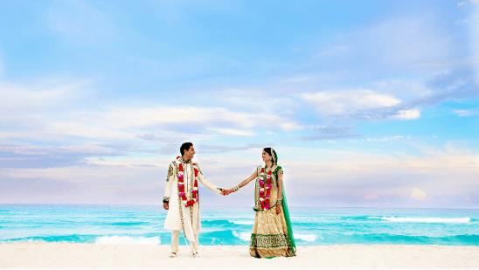
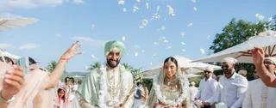
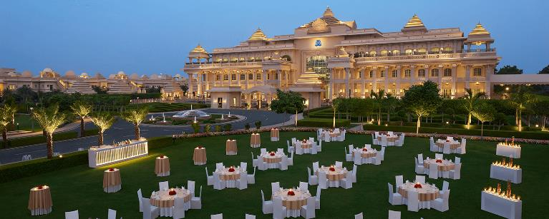
Accelerating Tourism India
Wedding Tourism
Notes:
https://www.imagesbazaar.com/previewImage/BY130375/ladakh/0/0/0/0/0/10/2

Slide 16
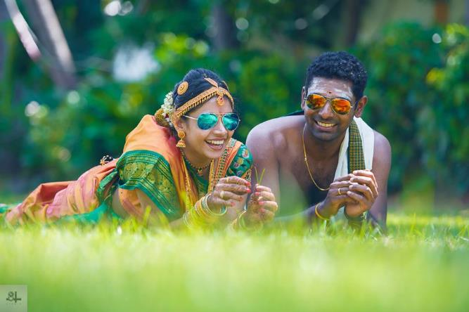
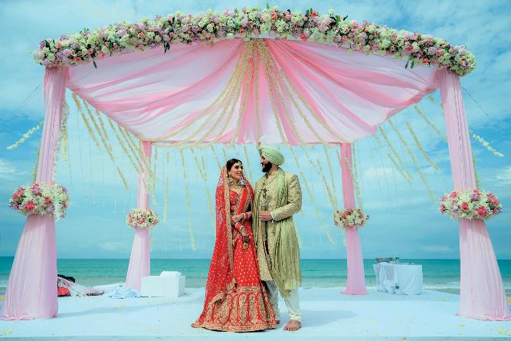
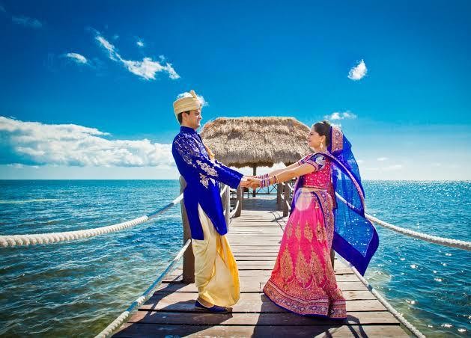
Inviting couples and their families to make their weddings..
# traditionally different

Slide 17
DRIVING SPOTLIGHT ON KEY CITIES WITH WEDDING TOURISM POTENTIAL
DEHRADUN
MUSSOORIE
SHIMLA
MAHABALESHWAR
KOCHI
KOVALAM
KASHMIR
ANDAMANS
SILIGURI
UDAIPUR
JODHPUR
JAIPUR
JAISELMER
BHUBHANSHWAR
AGRA
TAWANG
VISHAKAPATNAM
GOA
DALHOUSIE
MYSORE
TRIVANDRUM
ALAPUZHA
GWALIOR
SRINAGAR
AMRITSAR
HYDERABAD
RISHIKESH
Source: FICCI Wedding tourism report

Slide 18
AN INTEGRATED, 360 MODEL
WEDDING AND LIFESTYLE INFLUENCERS/PHOTOGRAPHERS/ETC
IDENTIFIED TOP NAMES FROM ACROSS OVERSEAS MARKETS AND REGIONS
ACROSS THEMES SUCH AS GREEN WEDDINGS
STRATEGIC ENGAGEMENT WITH
WEDDING PLANNERS
VIRTUAL EVENTS
CONTENT MARKETING
COMMUNITY INTERVENTIONS
PARTNERSHIPS WITH ASSOCIATIONS
# traditionally different
WEDDINGS
WEDDING PUBLICATIONS
AND FAIRS
PARTNERSHIPS AT COUNTRY / REGION LEVEL
EDITORIAL CONTENT, SOCIAL MEDIA INTEGRATION, ETC
SOCIAL MEDIA CAMPAIGNS
MONTHLY ASSETS
TENTPOLE CAMPAIGNS
LEVERAGING USER GENERATED ASSETS
6 Mn Intent audience
PARTNERSHIPS WITH
STATE LEVEL WEDDING ASSOCIATIONS
UNLOCKING THE COMBINED REACH OF
STATE LEVEL WEDDING ASSOCIATIONS
CULTURAL COMMUNITIES INTERVENTIONS
PUNJABI, TAMIL, TELEGU, GUJARATI, ETC
2.8 Mn Global Searches
SEARCH MARKETING
GLOBAL & DOMESTIC SEARCHES RELATED TO DESTINATION WEDDINGS
INVOLVING LOCAL COMMUNITES & GUIDES
TO DRIVE AUTHENTIC CONVERSATIONS AND EXPERIENCES ACROSS INDIAN & OTHER CUSTOMS, RITUALS AND MORE

Slide 19
THE ACTIVATION SCHEDULE
APRIL
MAY
JUNE
CAMPAIGN FLOW
Social media videos
Pre buzz
activities
Social media posts
Micro engagements
Campaign Launch
Hero
Campaign
Launch
Wedding and lifestyle Influencer engagements
Social media engagements
Paid media promotion through digital banners and YT videos
SEO & SEM
Campaign
Sustenance
Partner toolkits
Engagement with wedding planners

Slide 20
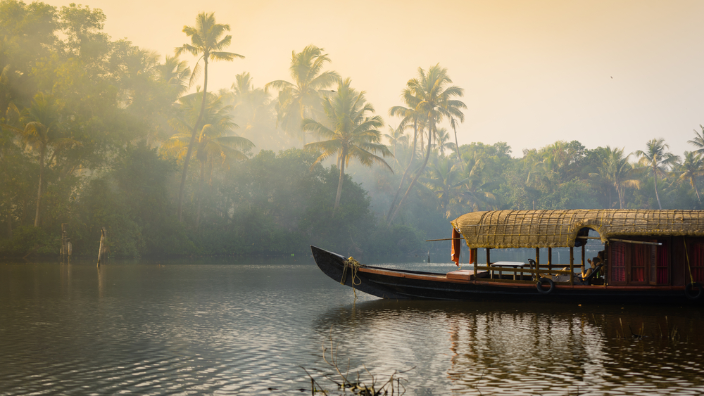
Thank you

